Slide 1
2021 CFC Application Training:
How to Submit A Successful Appeal
Office of Combined Federal Campaign

Slide 2
CFC Regulations: § 950.204
Denied charities may submit appeals to the Director of OPM
  Must be sent via the online, Charity Application System (Appeals submitted via email, mail or fax will not be considered)
  Requests must be received within 10 business days from the date that OPM sent the notification (untimely requests will not be accepted)
  The appeal must be limited to those facts justifying the reversal of the original decision
  Appeals may not be used to supplement applications with documents that did not exist or were not in final form before the application deadline
  The OPM Director’s decision is final for administrative purposes

Slide 3
Before Submitting Your Appeal (1/3)
Reference your denial notification to identify the application’s deficiencies
Read OPM’s Guidance on Submitting CFC Appeals
Read CFC Memo 2018-09 – CFC Application Standards on the Areas of Service: If your application was denied because of Step 4
Gather additional documentation and prepare an explanation to cure your application’s deficiencies
  Only submit documents (IRS Form 990 and financial statements) that were in final form prior to the application deadline (February 26, 2021)*
  Only report services that were provided prior to calendar year 2021

Slide 4
Before Submitting Your Appeal (2/3)
In limited circumstances, OPM will consider certain documents that were prepared after the application deadline due to the organization having difficulty obtaining required documents because of adherence to CDC COVID-19 social distancing guidelines and pandemic-related limitations with the company contracted to conduct audits or reviews of financial statements and/or prepare tax return.
The charity must submit a brief narrative in its appeal to explain why the documents were not available prior to the application deadline (February 26, 2021), as required by CFC Regulations at § 950.204.
Waiver requests of financial statements and/or tax documents requirements will not be considered.

Slide 5
Before Submitting Your Appeal (3/3)
Listen to this training in its entirety
CFC staff will not review any parts of a charity’s appeal before it is submitted to the OPM Director
This training, along with guidance previously mentioned, are the resources available to assist charities on how to cure application deficiencies
Only respond to the deficiencies noted in your eligibility letter
Take a deep breath
  Most deficiencies can be cured on appeal
  Majority of denied charities are successful on appeal

Slide 6

Appeal Decisions
Target date to notify charities is July 27
Initial eligibility decisions will either be:
  Overturned (approved)
  Sustained (denied)
The OPM Director’s decision is final
OPM will not consider additional requests for reconsideration

Slide 7
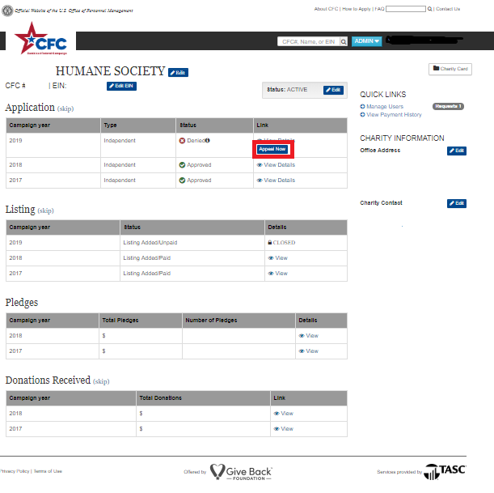

Slide 8
Step 3: Human Health & Welfare Services
Required of all CFC charities, including animal and environmental organizations
All 501(c)(3) organizations provide human health and welfare services
Read the statement and click “Yes” to certify to the statement

Slide 9
Step 4: Areas of Service
Only required of organizations with an Areas of Service(s) deficiency
OPM will not accept program brochures, annual reports, fact sheets, spreadsheets or other formats
Service descriptions are limited to 256 characters
  Any verbiage after the limit will not be considered
Each service description must include the number of beneficiaries and/or monetary value of the services
De minimis services will not be accepted: De minimis services are those where the number of beneficiaries and/or monetary value of the services had minimal impact

Slide 10
Appeals page will include the Areas of Services. Rhere is a “Pass” or “Fail” determination for each one
“Fail” submissions can be edited
Entries in a “Pass” status cannot be modified
Additional entries can be added for the appeal

Slide 11

Areas of Service: Local Orgs
Local organizations must report services provided in calendar year 2020
Local organizations must report only on the services provided in the local CFC zone to which they applied
Services provided in 2021 or in other local CFC zones
will not be accepted

Slide 12

Areas of Service: National & International Orgs
International and National/International organizations have a 3-year period (calendar years 2018, 2019, and 2020) from which to report services
Must include at least one eligible service in calendar year 2020
International organizations must have eligible services in at least one foreign country
National/International organization must have eligible services in at least 15 states and/or one foreign country
For each state and/or foreign country, an Areas of Service must be submitted
Services provided in 2021 will not be accepted

Slide 13
Web-based Services(1/3)
Real services for web-based service organizations may be considered if the organization provides:
The scope of services received by users:
  Description(s) detailing the real services, benefits, assistance or program provided via the Internet (entered on Step 4)
Service logs or other records indicating the geographic distribution of users in each state or foreign country.
  Table listing of the states and/or foreign countries of the users that benefitted from the web-based services
  Must have a way to identify individuals (e.g. names, initials, user IDs, etc)
  Example: New Mexico: Mary Hines, John Blake, Misty Smith, and Carl Tate
      New Hampshire: Ryan Jones, Nicole Tripp, Manuel Brown
      New York: Liz Jones, Bruce Fine, Patrick Sense, Sophia Sans
      Wisconsin: Ricardo Bean, Alice Davis, Ama Miller, Will Lopes
      District of Columbia: Wilson Taylor, Evans King, Turner Reyes
…and so on

Slide 14
Web-based Services (2/3)
And two of the following:
Evidence that recipients, including members of the general public, dues paying members or affiliate organizations, have registered for use of the Web site;
Examples: Registration information from video conferencing service, website
account registrations, student profiles for distance learning, church service online
registration
(B) Summary reports that document customer feedback, through service satisfaction
or utilization surveys, demonstration of two-way communications, such as an
online class, or other mechanisms; or
Examples: Video of archived virtual conference, training or interviews; training
evaluations from Survey Monkey, Zoom or some other source, test results from
online class that tested participants’ knowledge, customer feedback & complaints

Slide 15
Web-based Services (3/3)
(C) Documented evidence that recipients of web-based services paid a fee for the
service.
Examples: Link to payment site and information such as the names of users and
the fees paid, registry of students and private school tuition)
The examples are not exhaustive
Reports that reflect only the number of hits or visits to a web site are not enough to establish the provision of real services
If your organization is reporting web-based (virtual services), you must upload it on the appeals page

Slide 16
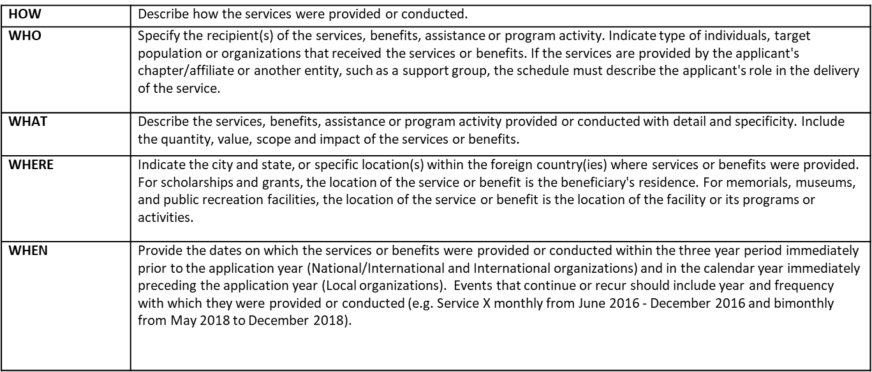
Areas of Service: Recommendations (1/2)

Slide 17
Areas of Service: Recommendations (2/2)
Use past tense, action verbs (e.g. serviced, delivered, granted, etc.)
Abbreviations are acceptable as long as they are easily recognizable
Grant making organizations must describe the services and/or benefits delivered with use of the awarded funds received by the recipients

Slide 18
Areas of Service: Things to Avoid (1/3)
Exceeding the 256 characters limit
Generalizing the nature of the activity
Including broad, vague, repetitive language, goals, and mission statements
Listing activities that were "offered” and/or “available” and other descriptors that do not convey an action
Listing services without providing context on who, what, how, when and where the service(s) were provided
These types of statements do not allow OPM to determine the actual services that were provided, the beneficiaries and location (local zone, state and/or foreign country)

Slide 19
Areas of Service: Things to Avoid (2/3)
Repetitive statements
Claiming fundraising as a service or benefit
Not using the Areas of Service format (e.g. submitting a brochure)
Provision of services via telephone or other electronic methods
Counting the location of members or visitors to a facility
Claiming services provided by another organization
Not providing specific local areas, states or foreign countries where the services were received
Not reporting services based on calendar year(s)
Media-related activities and research

Slide 20
Areas of Service: Things to Avoid (3/3)
Counting each individual family member
  A family is considered one unit
Counting animals as beneficiaries (e.g. we spayed 30 cats)
  For animal related services, an organization can count the humans who benefitted and/or the monetary value of the services
Reporting de minimis services

Slide 21
Areas of Service: De Minimis
De minimis services are those where the number of beneficiaries and/or monetary value of the services had minimal impact
Factors used to determine if the services are more than de minimis:
  Nature and extent of the service, benefit, assistance or activity
  Frequency, continuity, and duration
  Value of financial assistance awarded to individuals or entities
  Impact on, or benefit to, beneficiaries
  Number of beneficiaries

Slide 22
Areas of Service: Examples (1/6)
Deficiency | Non-Qualifying Example | Qualifying Example and/or Explanation of How to Correct
Broad descriptions of services Each service, activity or benefit should clearly be described in a separate Areas of Service entry | Listing out services, programs or benefits: “healthcare, tutoring, scholarships, and food bank, etc”. Charity Central held a Family Day attended by local physicians. | Training on diabetes management was provided to diabetics with limited access to health food stores. Low-income high school students received free SAT tutoring. The community food bank served residents in need by providing 2,000 pounds of food. Local physicians volunteered at Charity Central’s Family Day to provide free health screenings to San Francisco residents.

Slide 23
Areas of Service: Examples (2/6)
Deficiency | Non-Qualifying Example | Qualifying Example and/or Explanation of How to Correct
Repetitive service descriptions with or without differing numbers of beneficiaries served and/or monetary value of the services. | Providing the same service description for each geographic area. | Each service description on the Areas of Services should use differing verbiage to describe the organization’s services, activities and benefits. The number of beneficiaries and/or value of the services should also be unique for each service description.
Mission statements and/or describing the services “offered” and/or “available.” Service descriptions should report on the activities that were “provided, received, conducted, awarded and/or delivered.” | Our mission is to help residents live fully successful lives by providing family counseling and money management skills. The organization offers medical support to residents suffering from chronic illnesses. | Family counseling on healthy eating habits, financial planning and positive parenting was provided to 10 families. Residents suffering from chronic illnesses received primary care from the Community Health Center’s Nurse Practitioners.
Claiming fundraising activity as a service or benefit. | XYZ Institute conducted a fundraiser at the Portland Independence Day celebration that raised $22,000. 250 individuals contributed. | The organization can report on how it used the money that it raised (e.g. “XYZ Institute provided transitional housing and counseling services to 45 domestic abuse survivors.

Slide 24
Areas of Service: Examples (3/6)
Deficiency | Non-Qualifying Example | Qualifying Example and/or Explanation of How to Correct
Publications or other documents in lieu of a schedule detailing the services, benefits and activities. | OPM will not accept a program brochure, annual report, information sheet, and/or list of services, etc. to meet the Areas of Service requirement. Organizations must submit the information in the required OPM format. | Areas of Service includes the location, service description, year, number of beneficiaries and/or monetary value of the services.
Provision of services solely via telephone or other electronic methods (unless the service is emergency in nature such as a suicide prevention hotline) and distribution of mass-produced information. | Provided brochures on heart disease at various community events. | On 8/17, our outreach educators attended the county fair and educated participants on heart disease prevention and treatment and provided education brochures.
Location of residence of organization members or location of residence of visitors to a facility. | The Charity Museum, based in Philadelphia, recorded 300 visitors from the Seattle area in 2019. | This is not acceptable because in this example, the museum provided a service in Pennsylvania, where the facility is located. The fact that visitors to the Pennsylvania museum came from Washington does not mean that the museum's services were provided in the state of Washington.

Slide 25
Areas of Service: Examples (4/6)
Deficiency | Non-Qualifying Example | Qualifying Example and/or Explanation of How to Correct
Describing activities/services provided by an entity other than the applicant, such as a chapter or a support group. Applicant must document its role in the delivery of the service. Details may include items such as whether the chapter is funded by the applicant or how the applicant assisted in the delivery of the service. | ABC Charity's Colorado chapter held a workshop for local families interested in learning more about ABC's research programs. Our grant award to Dr. Michael Brown’s research study impacted 100 Alzheimer patients by providing promising alternatives to drug treatment. | This is not acceptable because this description shows only the activities of a local chapter or affiliate. In this case, the national applicant needs to show how it provides financial support, technical advice, or other services to the local chapter. A $10,000 grant award to Dr. Michael Brown advanced Alzheimer treatment by providing promising non-drug alternatives to combat the disease.
State that an activity was provided in numerous states, throughout the United States, nationwide or worldwide. | We provided legal advocacy to all juvenile offenders in the United States. | The Areas of Service must list each geographic area that the service, activity or program occurred without being repetitive.
Counting each individual member of a family as a beneficiary. | We delivered Thanksgiving baskets to 8 homes which fed 30 individuals. | We delivered Thanksgiving baskets to 8 homes which fed 4 families.
Counting animals as beneficiaries | We neutered 110 cats and 81 dogs. | We neutered cats and dogs which alleviated the stray animal problem in Bangor, ME.

Slide 26
Areas of Service: Examples (5/6)
Deficiency | Non-Qualifying Example | Qualifying Example and/or Explanation of How to Correct
Providing information to the media, such as authorship of an article for a newspaper, magazine, or journal, or serving as an interviewee or reference for a television news program, or the authorship of a book. The production and/or distribution of information, such as a report based on research, surveys conducted by the applicant organization, or publication of a policy position paper. | The LMNOP Society held its annual advocacy day and provided talking points to the media. | With regard to media-related activities, research, and reports, the applicant must describe the manner in which beneficiaries requested or used the document or information in order to establish the provision of a real service, benefit, assistance, or program activity. The LMNOP Society held its annual advocacy day and provided talking points to 30 volunteers on how to advocate to state legislators for increased medical research funding. The initiative resulted in a co-sponsored funding bill.
Statements such as "since inception," "ongoing," "2018 to present," "fiscal year 2019", or "2018-2020.” Services must be reported based on a calendar year. | In fiscal year 2019, we provided SAT prep to 200 high school students. | From March- May 2019, we provided SAT prep to 200 high school students.

Slide 27
Areas of Service: Examples (6/6)
Deficiency | Non-Qualifying Example | Qualifying Example and/or Explanation of How to Correct
De Minimis Services, Benefits, Assistance & Program Activities | One beneficiary served in Germany in each year during a 3-year period. | Five military families stationed in Germany received free day care services in 2020. Three military families stationed in Germany received counseling on financial planning and budgeting in 2020.

Slide 28
CFC Application Standards: Areas of Service
CFC MEMORANDUM 2018-09
https://www.opm.gov/combined-federal-campaign/reference-materials/memos/2018-cfc-memos/2018-09.pdf

Slide 29
Step 5: Exemption Status
Charities must certify to the correct statement based on their IRS tax exemption status and submit additional documentation, if required
Employer Identification Number (EIN):
  Chapters/affiliates share their EIN with other organizations (Option 3)
  Organizations that are part of a group exemption (Option 2) have their own (EIN); not shared
Chapters and/affiliates of a parent organization must submit a letter (CEO letter) to certify that the local office, explicitly named in the letter (Group 1):
  Operates in good standing of the national or local parent organization
  Is covered by the parent organization’s 501(c)(3) tax-exemption, IRS Form 990, and audited financial statements
  Signed and dated by the CEO (or equivalent) on or after October 1, 2020

Slide 30
Step 6: IRS Determination Letter (1/2)
EINs checked against the IRS Business Master File
Documentation only required if the EIN was not found:
  IRS Determination Letter
  CEO letter for chapters/affiliates
  Most recently published listing from places of worship (e.g. US Catholic Directory)
For discrepancies with the legal name of the organization, IRS Determination Letter, financial statements, and/or IRS Form 990, the organization must submit one of the following:
  Doing Business As (DBA) name documentation from the IRS or state government authorizing the use of a DBA name

Slide 31
Step 6: IRS Determination Letter (2/2)
  List of all organizations that are part of a group exemption
  CEO Letter
  Letter from IRS with the DBA name
Expired DBA documentation will not be accepted
Applications for DBA names will not be accepted

Slide 32
Step 7: Financial Statements (1/3)
Financial statements must be for a fiscal period that ended on or after June 30, 2019
  Same fiscal period as the IRS Form 990
Financial statements must be:
  Completed by an independent certified public accountant (CPA)
  Include a CPA report that is on letterhead
  Conducted in accordance with GAAP (audits and reviews) and GAAS (audits)
  Be signed and dated by the CPA prior to February 26, 2021
Audited and/or reviewed financial statements that were prepared and available after February 26, 2021 will not be accepted (see slide 4)

Slide 33
Step 7: Financial Statements (2/3)
If your application was denied because the financial statements were not accessible by OPM, an accessible document must be submitted on appeal
  Submitting a password protected or unreadable document will not result in a successful appeal
If your application was denied because the name on the financial statements was not the same as the legal name of the organization (listed on Step 6), then you must submit:
  Financial statements with the correct name;
  Acceptable DBA documentation

Slide 34
Step 7: Financial Statements (3/3)
An organization with an annual revenue of $250,000 or more as reported on the IRS Form 990 must submit audited financial statements
Those with an annual revenue of at least $100,000 but less than $250,000 are required to submit either audited or reviewed financial statements
Compiled financial statements will not be accepted
If the incorrect statement was certified, the organization must certify to the correct statement based on its total revenue reported on the IRS Form 990

Slide 35
Step 8: IRS Form 990, or pro forma (1/5)
An IRS Form 990, or pro forma IRS Form 990, that was prepared and available after February 26, 2021 will not be accepted (see slide 4)
  However, an IRS Form 990 that was amended and submitted to the IRS after the application deadline may be submitted
IRS Form 990EZ, PF, N and other variations will not be accepted
IRS Form 990, or pro forma IRS Form 990, deficiencies require a revision to the document
Revised IRS Form 990s must be amended with the IRS
  The document must be marked as amended and submitted to the IRS
  If your organization is submitting a pro forma IRS Form 990, you are not required to submit the revised document to the IRS

Slide 36
Step 8: IRS Form 990, or pro forma (2/5)
If your IRS Form 990, or pro forma IRS Form 990, was not accessible by OPM, an accessible document must be submitted on appeal
  Submitting a password protected or unreadable document will not result in a successful appeal
If your organization was denied for not submitting an IRS Form 990, or pro forma IRS Form 990, or the document could not be accessed, please ensure that your organization is in compliance with the financial statements requirement (refer to slide 33)
Ensure that financial statements are submitted on appeal (if not previously submitted with your original application) if your organization is required to submit audited or reviewed financial statements; failure to submit required financial statements will not result in successful appeals

Slide 37
Step 8: IRS Form 990, or pro forma (3/5)
The IRS Form 990 submitted on appeal must be signed and dated by an officer at the organization prior to February 26, 2021
Except in the cases of documents amended with the IRS, OPM will not accept an IRS Form 990, or pro forma IRS Form 990, that was dated after the application deadline
The IRS Form 990 must be for the same fiscal period as the financial statements submitted (if required) on Step 7
  For the 2021 application period, the documents must be for the fiscal period that ended on or after June 30, 2019
  If the two documents have different fiscal periods, the denial of eligibility will not be overturned

Slide 38
Step 8: IRS Form 990, or pro forma (4/5)
Part VIII (Line 12) must report the organization’s total revenue. If there was no revenue, enter “0”. OPM will not interpret a
blank response as $0
Part IX (Line 25) must report the Management and General Expenses (Column C) and Fundraising Expenses (Column D)
If there were no expenses in these categories, enter “0”; OPM will not interpret a blank response as $0
Part XII must report the accounting method used to prepare the form
  Accrual method is required to be in accordance with GAAP
  Exception is organizations with total revenue under $100,000 may use another method of accounting

Slide 39
Step 8: IRS Form 990, or pro forma (4/5)
If your application was denied because the name or EIN on the IRS Form 990 was not the same as the one on the CFC application, then you must submit:
  The IRS Form 990, or pro forma IRS Form 990, with the correct name;
  Acceptable DBA documentation

Slide 40
Pro forma IRS Form 990
The pro forma IRS Form 990 is not a different version of the IRS Form 990
It is the same form but with only certain parts completed for CFC purposes
A blank IRS Form 990 can be downloaded on Step 8 of the application
The following sections must be completed:
  Page 1, Items A-M;
  Part I (Summary)
  Lines 1-4 only;
  Part II (Signature Block);
  Part VII (Compensation - section A only);
  Part VIII (Statement of Revenues);
  Part IX (Statement of Functional Expenses); and
  Part XII (Financial Statements and Reporting)
Any required sections remaining incomplete will result
in an unsuccessful appeal

Slide 41
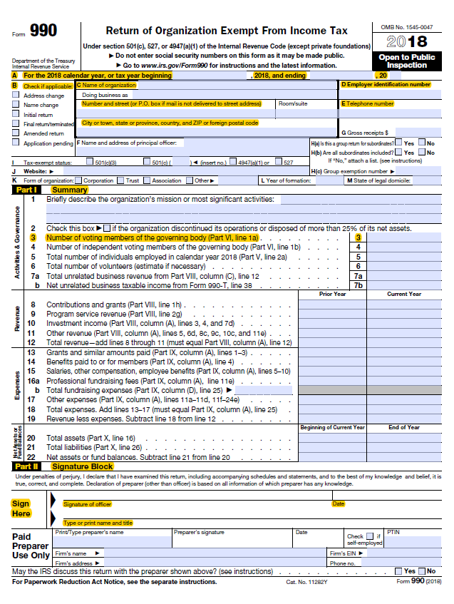

Slide 42
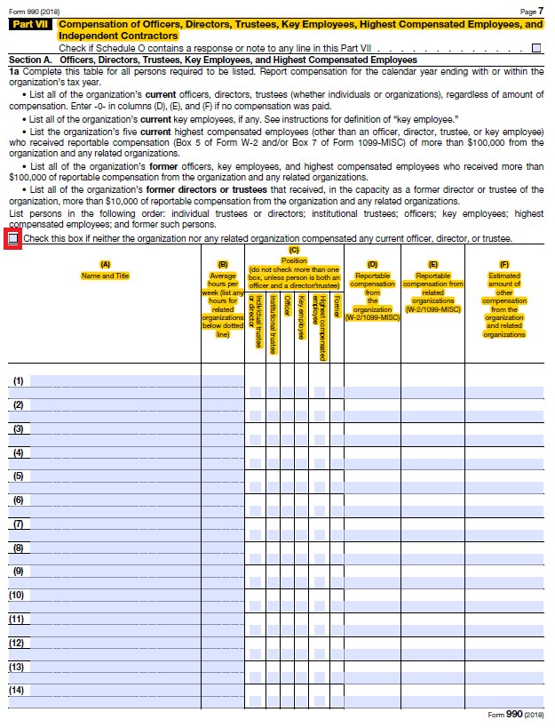

Slide 43
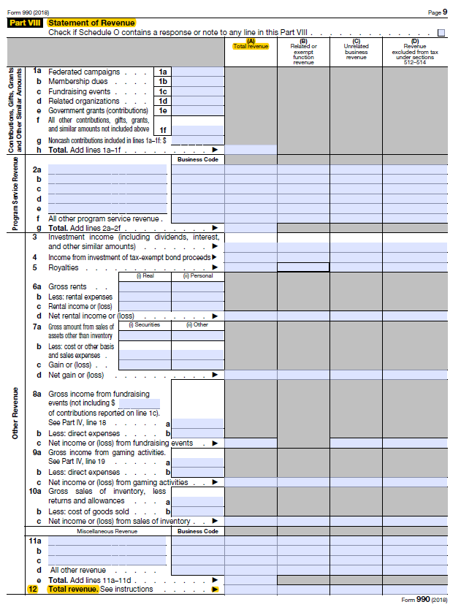

Slide 44
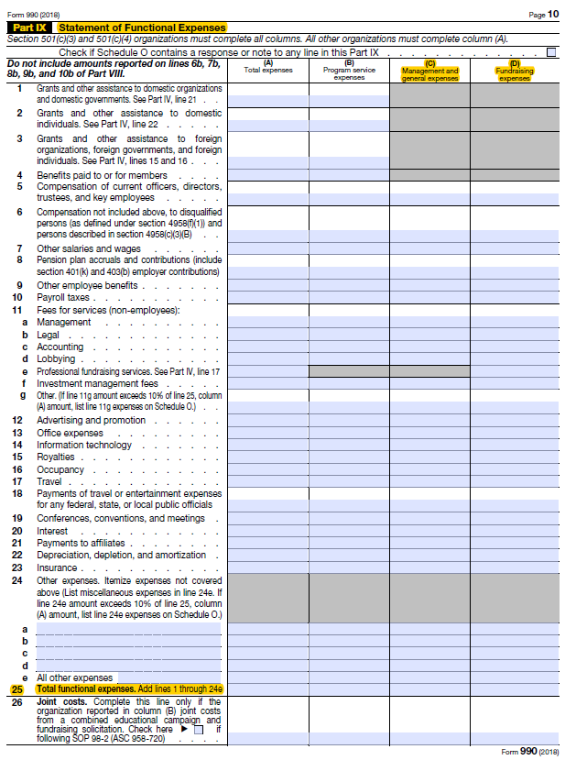

Slide 45
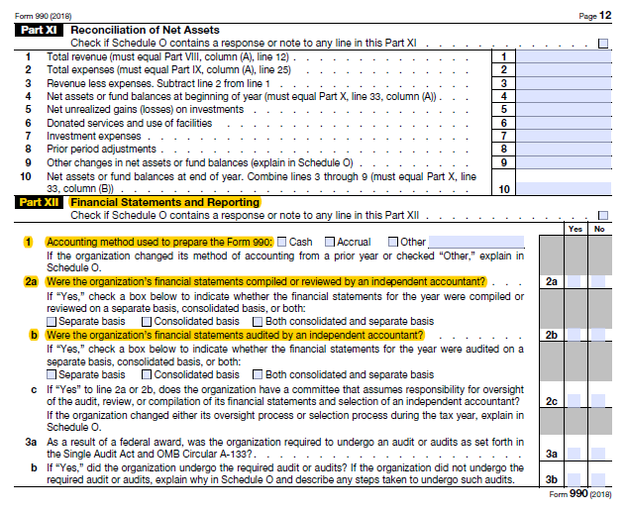

Slide 46
Board Governance (1/5)
Number of voting members (Part I, Line 3) must be equal to or less than the number of individuals reported as 'Individual trustee or director' or 'Institutional trustee’ (Part VII, Column C)
  The IRS Form 990 instructions define a 'director or trustee' as a member of the organization's governing body but only if the member has voting rights
  Therefore, individuals identified only as an 'Officer' do not count as trustees

Slide 47

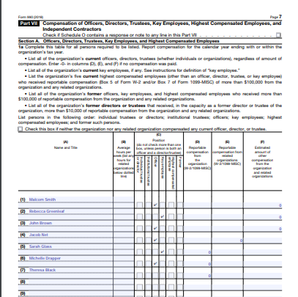

Slide 48

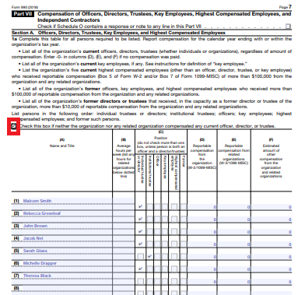

Slide 49
Board Governance (4/5)
For each trustee, compensation information must be reported on Part VII, Columns D, E, and F; each column must be completed
If no compensation was received, “0” must be entered or the box above the table on Part VII must be checked to disclose that neither the organization nor any related organization compensated any officer, director, or trustee during the fiscal period
  If no compensation was received, enter “0”. OPM will not interpret a blank response as $0
Changes to the reporting of the organization’s governing body on the IRS Form 990 requires that the document be amended and submitted to the IRS and to OPM (unless it is a pro forma IRS Form 990)

Slide 50
Board Governance (5/5)
The appeal will not be overturned if:
  The number of voting members (Part I, Line 3) exceeds the number of trustees (Part VII)
  Compensation information is not provided for each trustee (in Part VII, Columns D, E, and F)
  The majority of the trustees received compensation

Slide 51
Certification Statements
If your organization was denied because of missing and/or incorrect certification statements on Steps 3-11, you must certify to the correct statements
All organizations must certify to all certification statements, as applicable
It the certification statement(s) do not appear on the appeals page for your organization, copy and paste the applicable statements into a Word document, sign and date it, and upload it as a .pdf with your appeal

Slide 52
Appeal Decisions
Target date for decisions by OPM on all appeals is July 27th
Charity application records and CFC charity lists will be updated based on final appeal decisions
Charities with overturned denials (i.e. approved on appeal) must complete listing information and pay the listing fee by August 6
  All approved organizations must pay the listing fee to be included on the CFC Charity List
  Late payments will not be accepted
OPM encourages charities with sustained denials to reapply during the next application period which will begin in December 2021

Slide 53
Contact Us
For process & technical questions:
CFC Customer Care Center
support@cfccharities.org
(888)232-4935 (Toll Free)
(608)237-4935 (Local)
TTY: (800)203-8280 (Toll Free)
TTY: (608)268-7740 (Local)
For policy questions:
U.S. Office of Personnel Management
Office of CFC
cfc@opm.gov
(202)606-2564

